Slide 1
UNIVERSAL IMAGE FORENSICS USING MATHEMATICAL AND STATISTICAL ANALYSIS
FIRST REVIEW
Presented By
DINESHKUMAR S | - | 510822205004
KUMARESAN R | - | 510822205021
RUPESH V | - | 510822205039
SRIRAM D | - | 510822205046
PROJECT GUIDE Mrs.R.Savitha Assistant Professor |  | PROJECT COORDINATOR Prof.D.Durai Kumar Vice Principal ,HOD/IT

Slide 2
OBJECTIVE
PRIMARY OBJECTIVE:
To detect AI‑generated and deepfake images
SECONDARY OBJECTIVE:
To use mathematical and statistical image analysis
To provide explainable and transparent results
To ensure reliable real vs fake image classification

Slide 3
ABSTRACT
This project proposes an explainable method to detect AI‑generated and deepfake images.
It analyzes image properties such as frequency patterns, noise, texture entropy, and color correlation.
Mathematical and statistical formulas are used instead of black‑box deep learning models.
The system provides clear forensic reasoning to classify images as real or AI‑generated.

Slide 4
LITERATURE SURVEY

Slide 5
SNO | TITLE & YEAR | ALGORITHM/ METHODOLOGY/ TECHNIQUES | AUTHOR | ADVANTAGE | DISADVANTAGE
1 | TruthLens: Explainable DeepFake Detection (2025) | Hybrid multimodal + explainable reasoning | Rohit Kundu et al. | Provides interpretability & handles synthetic images | Computationally complex
2 | HFMF: Hierarchical Fusion … (2025) | Multi-stream deep network | Mehta et al. | Strong detection performance | Black-box
3 | Universal AI‑Generated Image Detection (2025) | Frequency Spectrum & Noise Analysis | Kumar et al. | Model‑agnostic, dataset‑independent | Lower accuracy on hybrids
4 | Multi‑Domain Deepfake Detection Framework (2025) | CNN + FFT + DCT Fusion | Lee et al. | Robust across domains | Complex architecture
5 | Statistical Forensics for AI Image Detection (2025) | Noise Residuals, Entropy Metrics | Rossi et al. | Explainable, lightweight | Sensitive to compression

Slide 6
SNO | TITLE & YEAR | ALGORITHM/ METHODOLOGY/ TECHNIQUES | AUTHOR | ADVANTAGE | DISADVANTAGE
6 | Diffusion Model Deepfake Detection (2025) | Reverse Diffusion Pattern Analysis | Wang et al. | Detects modern generators | Computationally heavy
7 | Compression Artifact‑Based Deepfake Detection (2025) | JPEG Artifact Consistency Check | Singh et al. | Fast, no training needed | Format‑dependent
8 | Hybrid Explainable Deepfake Detection System (2025) | Rule‑Based + ML Ensemble | Ahmed et al. | Balanced accuracy & explainability | Maintenance complexity
9 | Color Correlation Analysis for AI Images (2025) | RGB Channel Dependency Modeling | Fernández et al. | Simple, interpretable | Limited standalone accuracy
10 | Mathematical Forensic Framework for Image Authenticity (2025) | FFT, Entropy, Statistical Thresholding | Patel et al. | Fully explainable, forensic‑ready | Threshold tuning required

Slide 7
EXISTING SYSTEM
Existing systems use CNNs or transformer models trained on large datasets to classify images as real or AI-generated.
These models provide a final prediction (real/fake) but do not explain why an image is classified that way, reducing transparency and trust.
Detection accuracy depends heavily on the training data and specific AI models seen during training, making them less reliable for new or unseen generative techniques.

Slide 8
PROBLEM STATEMENT
Identifying real and AI generated images is difficult:
Modern generative models produce highly realistic visuals that closely mimic natural textures lighting noise and compression patterns across diverse real contexts.
Existing detection systems rely on black box deep learning:
Approaches offering limited explainability require large labeled datasets and often fail to generalize effectively when encountering new unseen AI generation techniques.

Slide 9
PROPOSED SYSTEM
The proposed system introduces a unified and explainable image forensic framework for detecting AI‑generated and deepfake images
It integrates frequency‑domain, spatial, statistical, and compression‑based image features to capture intrinsic artifacts that distinguish real images from synthetic ones.
Instead of relying on black‑box deep learning, the system employs mathematical and statistical feature extraction to ensure transparent and interpretable detection.
A lightweight machine‑learning classifier learns non‑linear relationships among extracted forensic features while preserving explainability.
The system provides image‑specific explanations, identifying which artifacts (FFT patterns, noise statistics, texture entropy, color correlation, compression effects) influence the classification.

Slide 10
PROPOSED SYSTEM
By explaining why an image is real or fake rather than outputting confidence scores, the system enhances trust, robustness, and accountability.
The proposed solution helps combat misinformation, digital fraud, and identity misuse, strengthening confidence in digital visual media.

Slide 11
System Specification
Hardware Requirements:
Processor
RAM
Storage
System Type
: Intel i5 or equivalent (min i3 supported)
: 8 GB (minimum 4 GB)
: 256 GB SSD or higher
: 64-bit architecture.

Slide 12
Software Requirements
Operating System
Programming Language
Frameworks & Libraries
: Windows / Linux
: Python 3.7 Higher
: TensorFlow / PyTorch, Keras, Scikitlearn,
Numpy, Matplotlib/Seaborn,Pandas
: Jupyter Notebook / VS Code / Anaconda
: SHAP / LIME
:CSV / TXT / JSON flies
Development Environment
Explainable AI (XAI) Tools
Dataset Handling

Slide 13
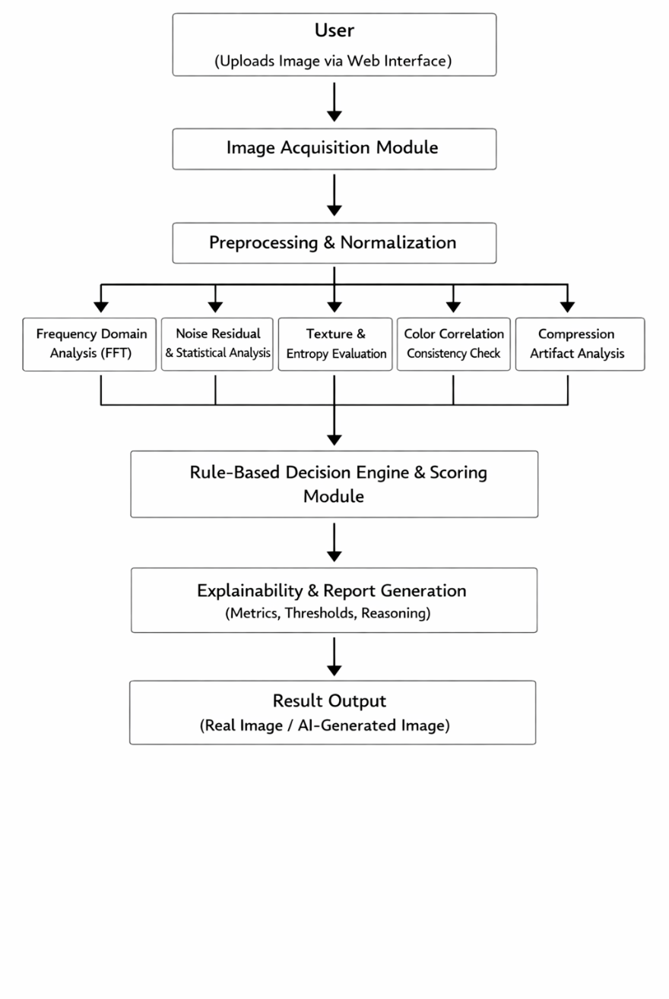
BLOCK DAIGRAM OF DEEPFAKE DETECTION

Slide 14
PROJECT DESCRIPTION
This project contains 5 modules and the modules are
Module 1: Front-End User Interface Module
This module develops the front-end interface for user interaction, including image upload and preview options. It is built using HTML, CSS, and JavaScript for a simple user experience.
It provides a result display layout and connects the user with backend modules. Drag-and-drop and device compatibility are supported.
This module handles only user interaction and display functions, not image processing.

Slide 15
Module 2: Image Preprocessing Module
This module prepares the uploaded image for analysis by improving its quality. It includes resizing, noise removal, contrast enhancement, and grayscale conversion.
These steps standardize the image format and reduce unwanted distortions. This ensures the data is clean and consistent for further processing.
The module focuses only on image improvement, not on feature detection or decision-making.

Slide 16
Module 3: Feature Extraction Module
This module extracts important characteristics from the image for analysis. It detects edges, textures, and pixel intensity patterns.
It also calculates histogram values and statistical measures such as mean and variance. These features convert the image into numerical data.
The module’s role is only to collect meaningful image information, not to classify the image.

Slide 17
Module 4: Mathematical & Statistical Analysis Module
This module analyzes the extracted features using mathematical and statistical techniques. It applies histogram analysis, Fourier Transform, and deviation measurements.
Pixel distribution is compared with expected values, and thresholds are applied to detect irregularities. This helps identify possible manipulation.
This module performs the core decision-making without using machine learning.

Slide 18
Module 5: Result & Report Module
This module presents the final output to the user in a clear format. It displays the image status along with statistical values and graphs.
The system may highlight abnormal regions and provide a confidence level. It also allows the result report to be saved or downloaded.
This module focuses on output presentation and documentation of results.
`

Slide 19
MODULE IMPLENTATION
MODULE 1 – WEB INTERFACE :
Web interface created for image upload using HTML form and Flask server connection
<form method="post" enctype="multipart/form-data">
<input type="file" name="file" required>
Image sent to server using HTTP POST request for backend processing
@app.route("/", methods=["GET","POST"])
if request.method == "POST":
Uploaded image file received in Flask using request.files
file = request.files["file"]
Secure file handling applied using secure_filename() to prevent invalid paths
from werkzeug.utils import secure_filename
filename = secure_filename(file.filename)
Image stored in server directory uploads/ for further processing
path = os.path.join("uploads", filename) file.save(path)

Slide 20
MODULE 2 - IMAGE PREPROCESSING:
Images loaded into the system using OpenCV cv2.imread() to read the uploaded image file
image = cv2.imread(path)
Images resized to a fixed dimension using cv2.resize() to ensure uniform analysis size
image = cv2.resize(image, (256, 256))
Image converted from RGB to grayscale using cv2.cvtColor() for intensity‑based processing
gray = cv2.cvtColor(image, cv2.COLOR_BGR2GRAY)
Noise reduction applied using cv2.GaussianBlur() to smooth the image and remove disturbances
blurred = cv2.GaussianBlur(gray, (7, 7), 0)
Pixel intensity normalized using cv2.normalize() to balance brightness and contrast
norm = cv2.normalize(blurred, None, 0, 255, cv2.NORM_MINMAX)

Slide 21
MODULE 3 – FEATURE EXTRACTION MODULE • Frequency‑domain features extracted using Fast Fourier Transform (FFT) to analyze spectral artifacts f = np.fft.fft2(gray) fshift = np.fft.fftshift(f) • High‑frequency energy ratio computed to detect AI‑generated frequency patterns fft_ratio = high_freq_energy / total_energy • Noise characteristics extracted by subtracting Gaussian‑blurred image noise = gray.astype(float) - blur.astype(float) noise_variance = np.var(noise) • Texture randomness measured using Shannon Entropy entropy = shannon_entropy(gray) • Color dependency analyzed using RGB channel correlation corr = np.corrcoef(r.flatten(), g.flatten())[0,1] • Compression artifacts detected using blockiness analysis across 8×8 pixel boundaries

Slide 22
MODULE 4 – MATHEMATICAL & STATISTICAL ANALYSIS MODULE • Extracted feature values compared against predefined forensic thresholds if fft_ratio > 0.85: • Rule‑based scoring applied to identify suspicious image characteristics rule_score += weight • Feature normalization performed to balance different value ranges normalized_score = rule_score / max_score • Statistical confidence calculated using weighted feature contributions final_score = 0.7 * ml_prob + 0.3 * rule_score

Slide 23
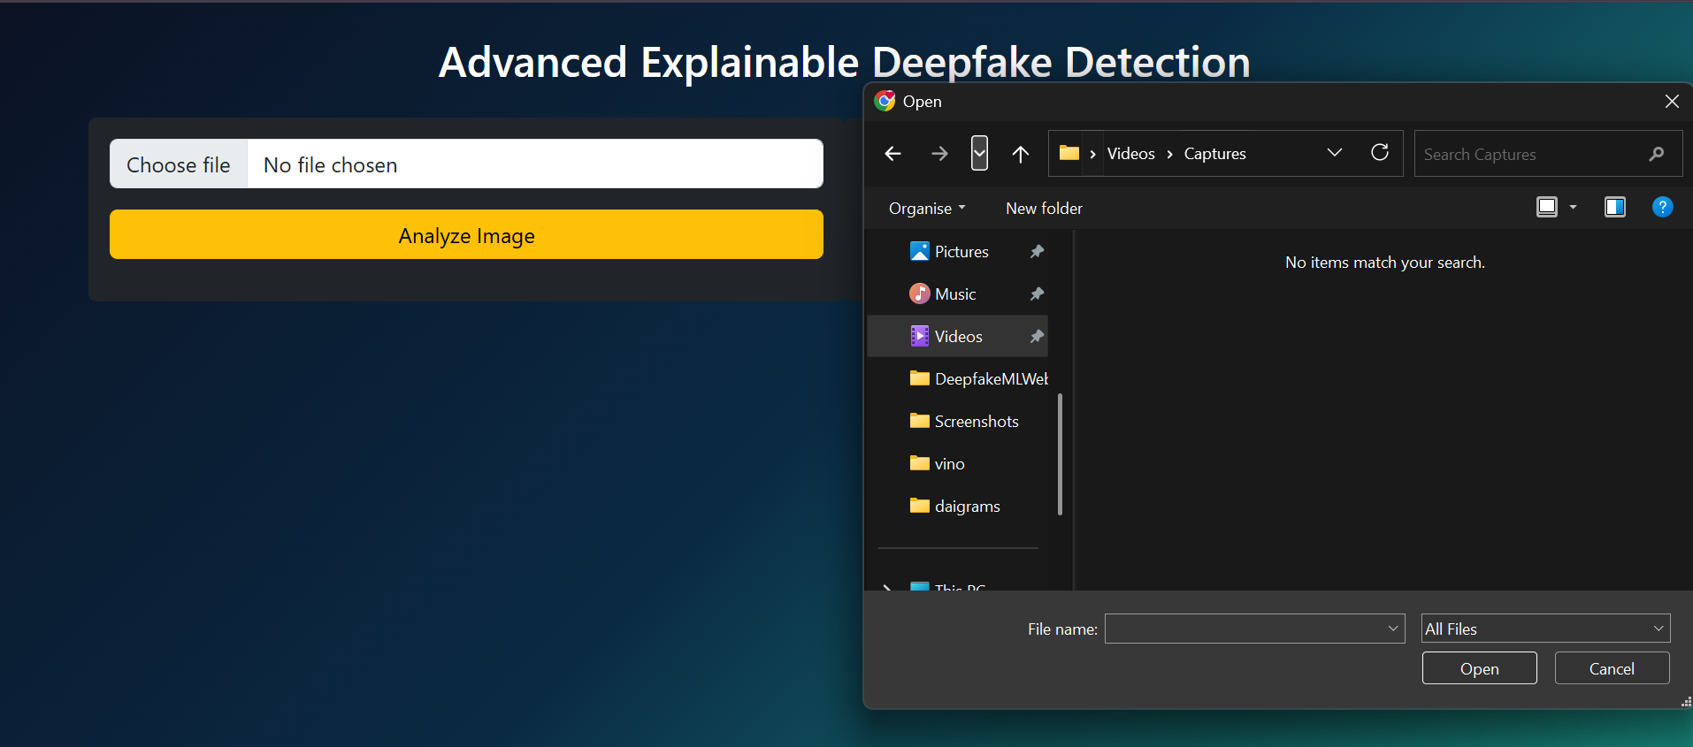
SNAP SHOTS:

Slide 24
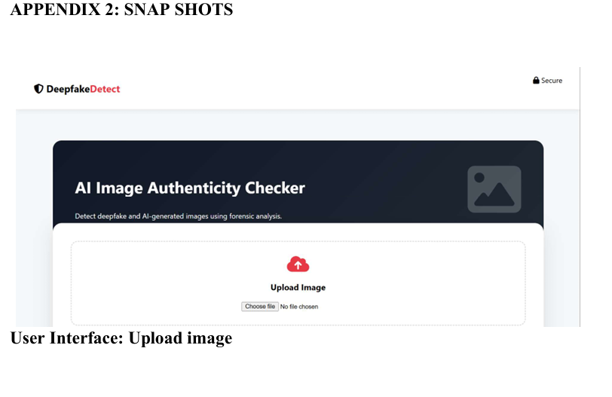

Slide 25
